Slide 1
Gastrulation
Benjamin Towbin
Institute of Cell Biology, University of Bern
benjamin.towbin@unibe.ch
www.towbinlab.org

Slide 2
zebra fish development

Slide 3
Embryonic development can be divided in distinct morphological stages
Blastula
Gastrulation
Organogenesis

Slide 4
Learning goals
Know:
- when gastrulation occurs
- the three germ layers and how they are formed and what tissues they make
Understand:
- the Spemann-Mangold experiment
- the term cell fate determination
- how morphogen gradients pattern the embryo

Slide 5
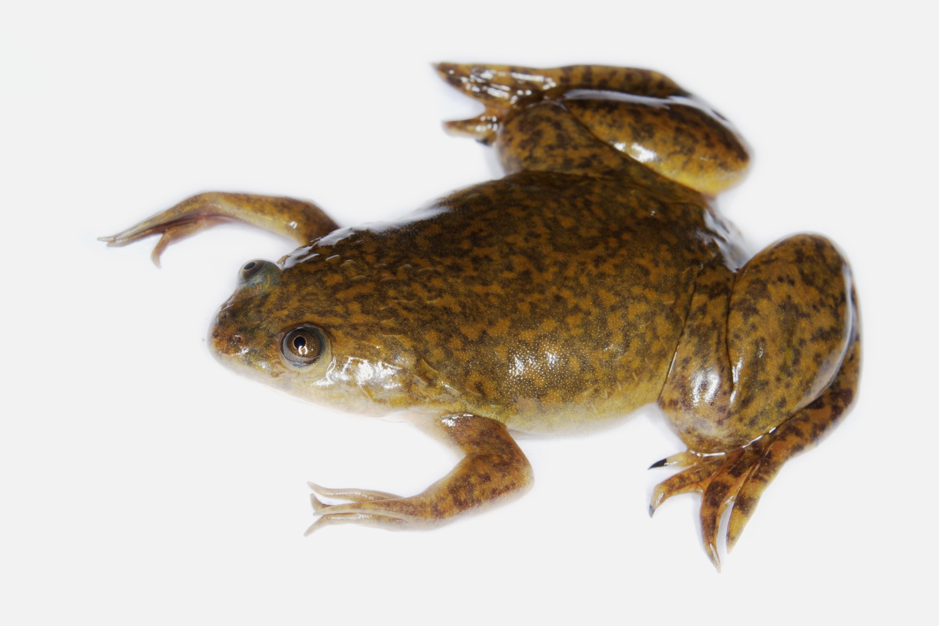
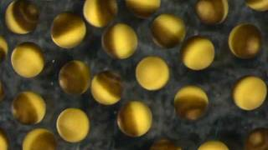
Amphibians have long served as a powerful model system to study gastrulation
Xenopus laevis
Xenopus eggs
large size (> 1 mm)
can be physically manipulated (transplantation)
molecular principles conserved to other species

Slide 6
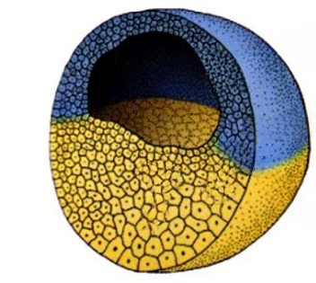
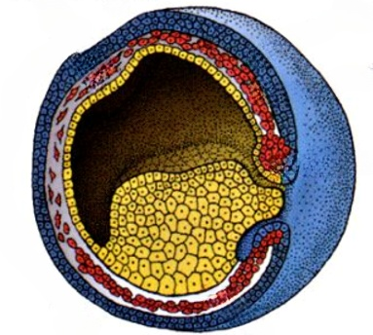
Gastrulation: movement of cells and cell fate specification
animal pole
ectoderm
skin, nervous system
blastocoel
mesoderm
inner organs
endoderm
digestive tract
vegetal pole
Blastula
Gastrula
1. Morphogenesis: cells need to move to the right place
2. Cell fate determination: cells need to know what to do
Figures adapted from Wolpert – Principles of development

Slide 7
Source of Figures: Scott Gilbert – Developmental Biology

Slide 8
Source of Figures: Scott Gilbert – Developmental Biology

Slide 9
Source of Figures: Scott Gilbert – Developmental Biology

Slide 10
Source of Figures: Scott Gilbert – Developmental Biology

Slide 12
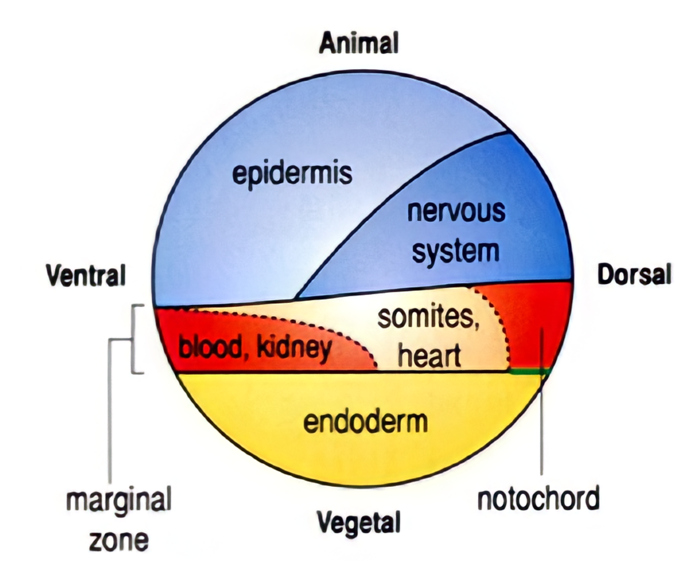
Part II: Cell fate determination
fate map of the blastula
fate map
≠
cell fate determination
Cell fate determination: Process during which a cell is determined to develop a specific cell type, independent of its neighbourhood.

Slide 13
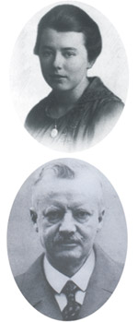
Hans Spemann was an influential developmental biologist in the 1920s
fate map:
skin cells
fate map:
neural cells
early gastrula
Hans Spemann
University of Freiburg (Germany)

Slide 14
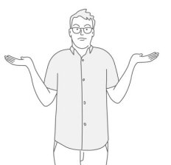
Spemann’s transplantation experiments showed that early gastrula tissues are not pre-determined
Early gastrula: Cells are not committed to a cell fate
Poll: Is the fate of the presumptive neural ectoderm already specified during early gastrulation?
presumptive
neural tissue
place in region that
normally forms
epidermis
neural plate
donor
acceptor
donor cells
form epidermis
yes
no
don’t
know
transplanted cells adopt the fate of their new location
left hand up
right hand up
find original article here (in German): https://link.springer.com/content/pdf/10.1007/BF02267308.pdf

Slide 15
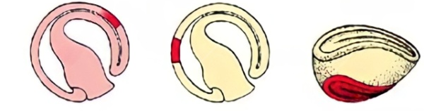
The cell fate of late gastrula tissues is determined
Late gastrula: Cells are committed to a cell fate
presumptive
neural tissue
place in region that
normally forms
epidermis
neural plate of acceptor
donor
acceptor
second neural plate forms
from donor cells
transplanted cells retain the cell fate of their origin
find original article here (in German): https://link.springer.com/content/pdf/10.1007/BF02267308.pdf

Slide 16
How do cells know what they should become?

Slide 17
In 1924, Hilde Mangold and Hans Spemann showed that the dorsal blastopore lip instructs gastrulation
Hilde Mangold
Hans Spemann
link to original article: https://link.springer.com/article/10.1007/BF02108133
University of Freiburg (Germany)

Slide 18
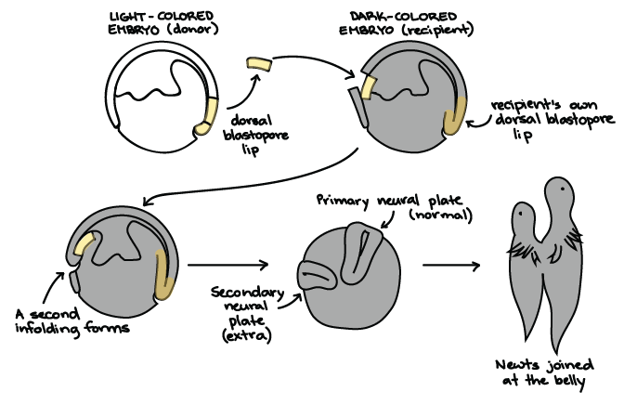
The dorsal blastopore lip induces gastrulation and neural plate formation
In 1935, Spemann received the Nobel prize for his discoveries

Slide 19
The blastopore lip can induce and organise the development of an entire orgasim
How is the Spemann-Mangold organizer specified?
Spemann-Mangold organizer
How does the Spemann-Mangold organizer instruct cell fates during gastrulation?

Slide 20
Morphogens are secreted molecules that control the cell fate of neighbouring cells
source of
morphogen
morphogen gradient

Slide 21
Integration of multiple morphogen gradients can instruct localized cell fates
+
VegT, Vg1
Wnt/β-catenin
morphogen gradients that are tilted to each other encode spatial information

Slide 22
Integration of multiple morphogen gradients can instruct localized cell fates
+
few more
steps
VegT, Vg1
Wnt/β-catenin
organizer
Note: more molecules and gradients are involved. I simplified here!

Slide 23
The specified organizer secretes morphogens that induce cell fates
+
few more
steps
VegT, Vg1
Wnt/β-catenin
organizer secretes:
noggin, chordin, ...
morphogen gradients that are tilted to each other encode spatial information

Slide 24
Interconnection of cell movement and specification creates a dynamics self-organizing system
Morphogen gradients
Change cell fate
cells move
To understand such complex dynamics, modern developmental biology often makes use of mathematical and computational models of the processes involved.

Slide 25
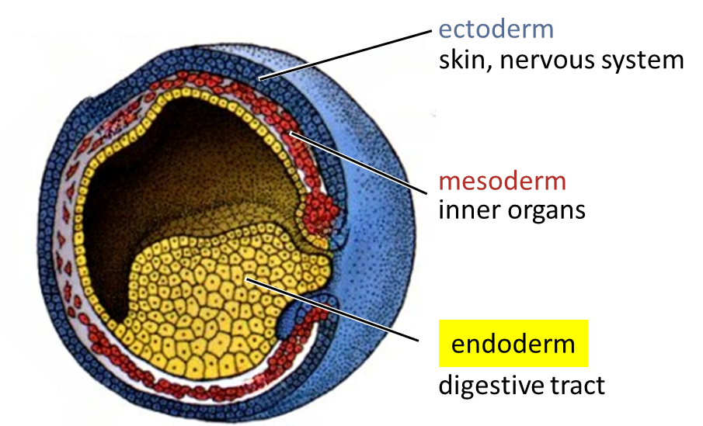
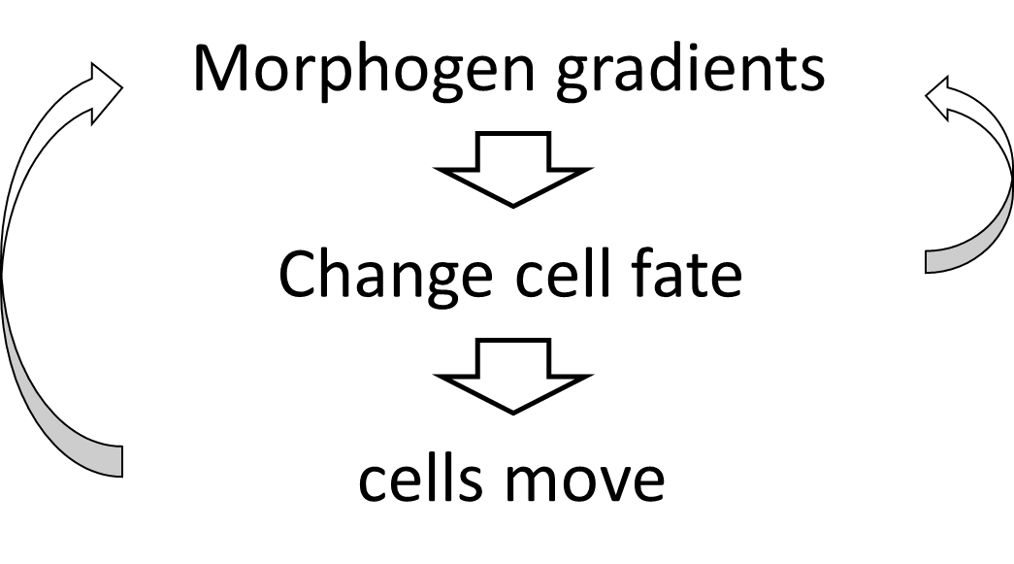
Summary
1. Gastrulation:
movement and specification of cells
forming three germ layers:
endoderm, mesoderm, ectoderm
2. Cell fate map ≠ cell fate determination
3. Spemann & Mangold defined the blastopore lip as an organizer of development
4. Multi-dimensional morphogen gradients pattern the embryo
5. Robust embryonic development results from self-organizing dynamic process
Find slides and original Spemann articles here: www.towbinlab.org

